Slide 1

Acute leukemia
Samantha Nier, ALAN Network Director
Reviewed by Dr Giovanni Marconi (January 2024)
www.acuteleuk.org

Slide 2
Agenda
What is (acute) leukemia
Acute Myeloid Leukemia (AML)
Acute Lymphocytic Leukemia (ALL)
Other types of acute leukemia
Note: this training focusses about acute leukemia in adult patients

Slide 3
What is (ACUTE) leukemia

Slide 4
What is leukemia ?
Leukemia is a cancer that starts in blood stem cells. Stem cells are basic cells that develop into different types of cells that have different jobs.
Blood stem cells develop into either lymphoid stem cells or myeloid stem cells.
Lymphoid stem cells develop into lymphocytes, a type of white blood cell. Lymphocytes help fight infection and destroy abnormal cells. The 3 types of lymphocytes are B cells, T cells and natural killer (NK) cells.
Myeloid stem cells develop into red blood cells, granulocytes, monocytes or platelets. Red blood cells carry oxygen to all tissues of the body. Granulocytes and monocytes are types of white blood cells that destroy bacteria and help fight infection. Platelets form clots in damaged blood vessels to stop bleeding.
As the stem cells of the blood develop, they become blast cells (blasts), which are immature blood cells. In leukemia, there is an overproduction of blast cells. These blast cells develop abnormally and don’t develop into mature blood cells. Over time, the blast cells crowd out normal blood cells so that they can’t do their jobs.
When leukemia is diagnosed, these blast cells may be called leukemia cells.

Slide 5
What is leukemia ?
There are many different types of leukemia. They are grouped based on the type of blood stem cell they developed from.
Lymphocytic leukemias (also known as lymphoblastic leukemias) develop from abnormal lymphoid stem cells.
Myelogenous leukemias develop from abnormal myeloid stem cells.
The types of leukemia are further grouped based on how quickly the leukemia develops and grows.
Acute leukemias start suddenly, developing within days or weeks.
Chronic leukemias develop slowly over months or years.
The 4 main types of leukemia are :
acute lymphocytic leukemia (ALL),
acute myelogenous leukemia (AML),
chronic lymphocytic leukemia (CLL) and
chronic myelogenous leukemia (CML).
In adults, CLL and AML are the most common leukemias, while in children ALL is the most common leukemia. There are many different subtypes of leukemia.

Slide 6
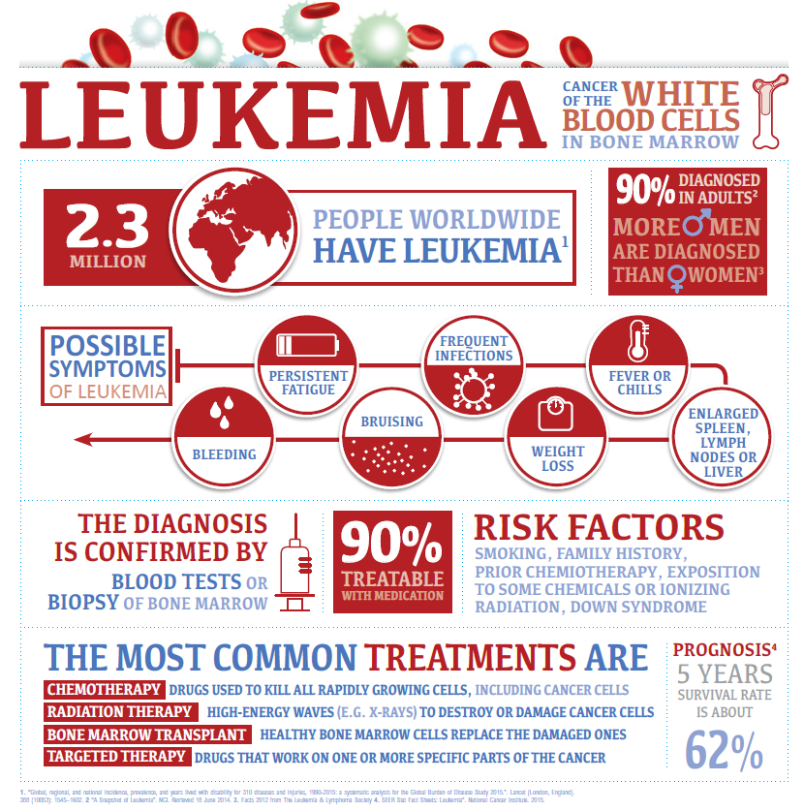
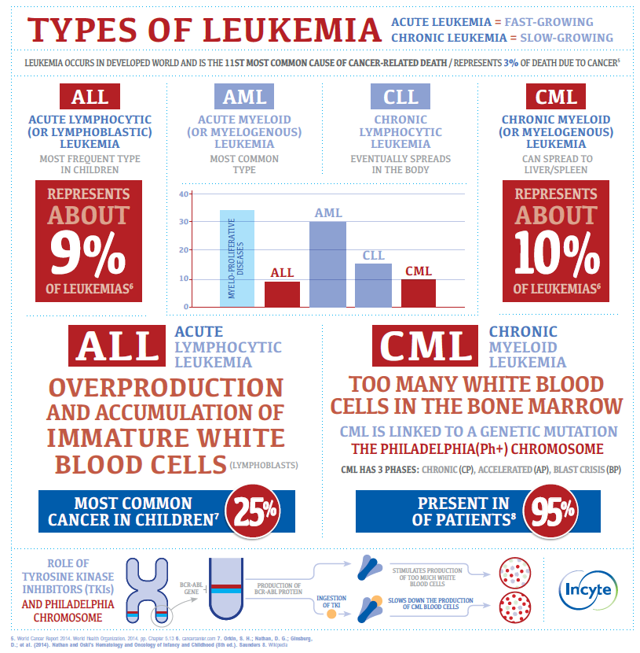

Slide 7
The blood and bone marrow
The blood is made up of blood cells in a liquid called plasma. Blood cells are made in the bone marrow. Bone marrow is the soft, spongy area inside most bones.
Blood
Blood is a mixture of plasma and blood cells. Plasma is mostly water but also has protein, salts, fats and sugar (glucose). Blood carries oxygen, carbon dioxide, nutrients, waste products, cells and hormones. It is part of the circulatory system that includes the heart and blood vessels. Testing the blood is an easy way for doctors to look for signs of disease and manage treatment for disease.
Types of blood cells
There are 3 types of blood cells – red blood cells, white blood cells and platelets.
Red blood cells (erythrocytes) carry oxygen to all cells in the body. The oxygen is carried to cells on a protein in red blood cells (called hemoglobin). Hemoglobin is what makes the blood red. It also carries carbon dioxide away from cells so that it can be exhaled by the lungs. Almost all of the cells in the blood are red blood cells.
White blood cells (leukocytes) are an important part of the immune system. They fight infection by defending the body against bacteria, viruses and other germs. Most of the body’s white blood cells are outside the blood, in other tissues of the body. Normally, there are very few white blood cells in the blood.
Platelets (thrombocytes) make the blood clot and help stop bleeding. When a blood vessel is damaged, platelets travel to the area and clump together.

Slide 8
The blood and bone marrow
Types of white blood cells
There are different types of white blood cells. Each type has a different job.
Lymphocytes make antibodies to fight infection. They are found in the lymph nodes, thymus, spleen, tonsils, adenoids and bone marrow. They are also found in lymphatic tissue in other parts of the body, such as the appendix, the small intestine and other parts of the digestive system and respiratory system.
The 3 main types of lymphocytes are:
B cells, which make antibodies to fight bacteria, viruses and other foreign material, such as fungi
T cells, which fight infection, destroy abnormal cells and control the immune response
natural killer (NK) cells, which attack any foreign cells
Granulocytes fight infection and become active in response to tissue inflammation.
The 3 main types of granulocytes are:
neutrophils, which fight infection by surrounding and eating (ingesting) bacteria
eosinophils and basophils, which attack and destroy certain parasites and are activated during an allergic reaction
Monocytes help fight infection by changing into cells called macrophages, which eat foreign invaders, such as bacteria and waste from dying cells.

Slide 9
The blood and bone marrow
How blood cells are formed
Blood cells are formed through a process called hematopoiesis. All blood cells develop from young, immature cells called stem cells. Stem cells can change into the different types of cells, depending on what the body needs. Stem cells develop and mature into the various types of cells by a process called differentiation.
Stem cells
Stem cells are found in the bone marrow, blood and umbilical cord blood. Stem cells develop into blood cells in the bone marrow. When blood cells are mature and able to function, they leave the bone marrow and move into the blood.
In adults, most stem cells are found in the bone marrow. Stem cells can also be found in smaller amounts in the bloodstream. These are called peripheral blood stem cells. Umbilical cord blood also has stem cells but there are fewer stem cells than those in the bone marrow and blood.

Slide 10
The blood and bone marrow
How blood cells are formed (cont.)
Blood cell development
In the earliest stage of blood cell development, stem cells begin to develop into either the lymphoid cell line or the myeloid cell line. In both cell lines, the stem cells become blasts, which are still immature cells.
Lymphoid cell line
Lymphoid stem cells develop into lymphoblasts, which develop into lymphocytes. Lymphocytes are a type of white blood cell. Lymphocytes help fight infection and destroy abnormal cells.
Myeloid cell line
Myeloid stem cells develop into red blood cells, platelets and other types of white blood cells (neutrophils, eosinophils, basophils and monocytes). Red blood cells carry oxygen to all tissues of the body. Platelets form clots in damaged blood vessels to stop bleeding.
Myeloid progenitor cells develop into 2 different types of white blood cells – granulocytes and monocytes. These white blood cells destroy bacteria and other foreign invaders and help fight infection.

Slide 11
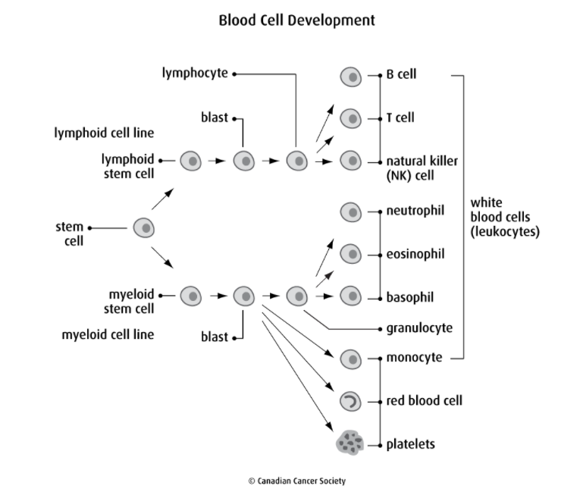
The blood and bone marrow
Source: Canadian Cancer Society

Slide 12
The blood and bone marrow
Bone Marrow
Bone marrow is the soft, spongy area inside most bones. It makes blood cells.
There are 2 main types of bone marrow – red and yellow.
Red bone marrow is where stem cells develop into red blood cells, white blood cells and platelets.
Yellow bone marrow stores fatty tissue.
In adults, the bone marrow that makes the most blood cells is found in the hip bones (bones of the pelvis), shoulder bones (scapula), bones of the spine (vertebrae), ribs, breastbone (sternum) and skull.

Slide 13
Acute myeloid leukemia (AML)

Slide 14
What is AML ?
Acute myelogenous leukemia (AML) is a cancer that starts in blood stem cells. Stem cells are basic cells that develop into different types of cells that have different jobs
→ It is a clonal malignant disease of myeloid cells
→ It is called acute because it develops quickly = emergency
As the stem cells of the blood develop, they become blast cells (blasts), which are immature blood cells. In leukemia, there is an overproduction of blast cells. These blast cells develop abnormally and don’t develop into mature blood cells. Over time, the blast cells crowd out normal blood cells so that they can’t do their jobs. When leukemia is diagnosed, these blast cells may be called leukemia cells.
Acute myelogenous leukemia is also called acute myeloid leukemia, acute myelocytic leukemia, acute myeloblastic leukemia [historically also acute granulocytic leukemia or acute non-lymphocytic leukemia (ANLL)].
AML is more commonly diagnosed in developed countries
→ Annual incidence rate in Europe is about 3,62 per 100 000
AML is one of the more common types of leukemia in adults (=25% of all leukemias)
It is less common in children.
In general risk increases with age
Most common in people over 65 years old

Slide 15
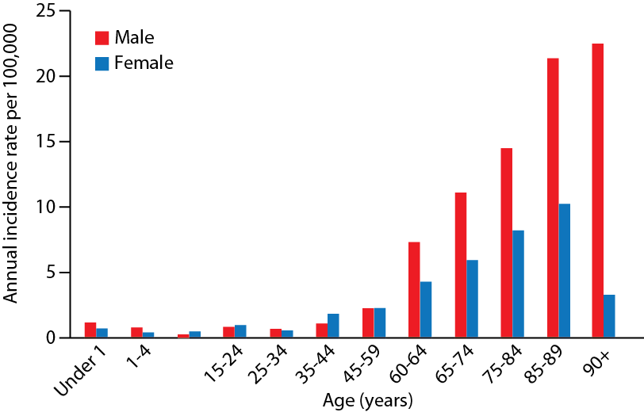
Typically, a disease of the elderly
Notes:
Burnett AK, Venditti A. Postgraduate Haematology. Oxford: Blackwell Publishing Ltd; 2011.

Slide 16
Clinical symptoms
Loss of appetite or weight loss
Mild fever
Symptoms and signs of altered function of blood cells
Red blood cells - anemia
Fatigue
Shortness of breath on exertion
Platelets – thrombocytopenia
Easy bruising
Petechiae
Bleeding in the nose or from the gums
Prolonged bleeding from minor cuts
White blood cells (importantly neutrophils) – leukopenia/neutropenia
Recurrent minor infections or poor healing of minor cuts
Pneumonia
Notes:
Pallister, C and Watson MS. Haematology. Scion Publishing 2011

Slide 17
Predisposing Factors
Antecedent Blood Disorder | Environmental Factors & Lifestyle | Drugs | Genetics
Myelodysplastic syndromes (MDS) | Radiation exposure | Alkylating agents (cyclophosphamide, melphalan, nitrogen mustard) | Inherited chromosome abnormalities (Down, Patau
Chronic myeloid leukemia | Benzene | Topo-II inhibitors (etoposide, teniposide) | Germline GATA2 deficiency (Fanconi, Shwachmand-Diamond, Kostmann)
Polycythemia vera | Smoking | Chloramphenical | Bloom syndrome
Essential thrombocythemia | Alcohol use | Phenylbutazone | Li fraumeni (TP53 mutation)
Myelofibrosis | Dyes | Chloroquine | Familial platelet disorders (RUNX1, ANKRD26, ETV6
Paroxysmal nocturnal hemoglobinuria | Herbicides | Methoxypsoralen | Telomeropaties
Aplastic anemia | Pesticides | Parp inhibitors | Ras.opaties
 | Obesity |  | Wiskott-Aldrich syndrome
 |  |  | Ataxia-teleangiectasia
 |  |  | Other rare inherited mutations (CBPA, DDX41, SAMD9, SAMD9L)
Notes:
Tamamyan. Crit Rev Oncol. Hematol. 2017;110:20.
WHO22

Slide 18
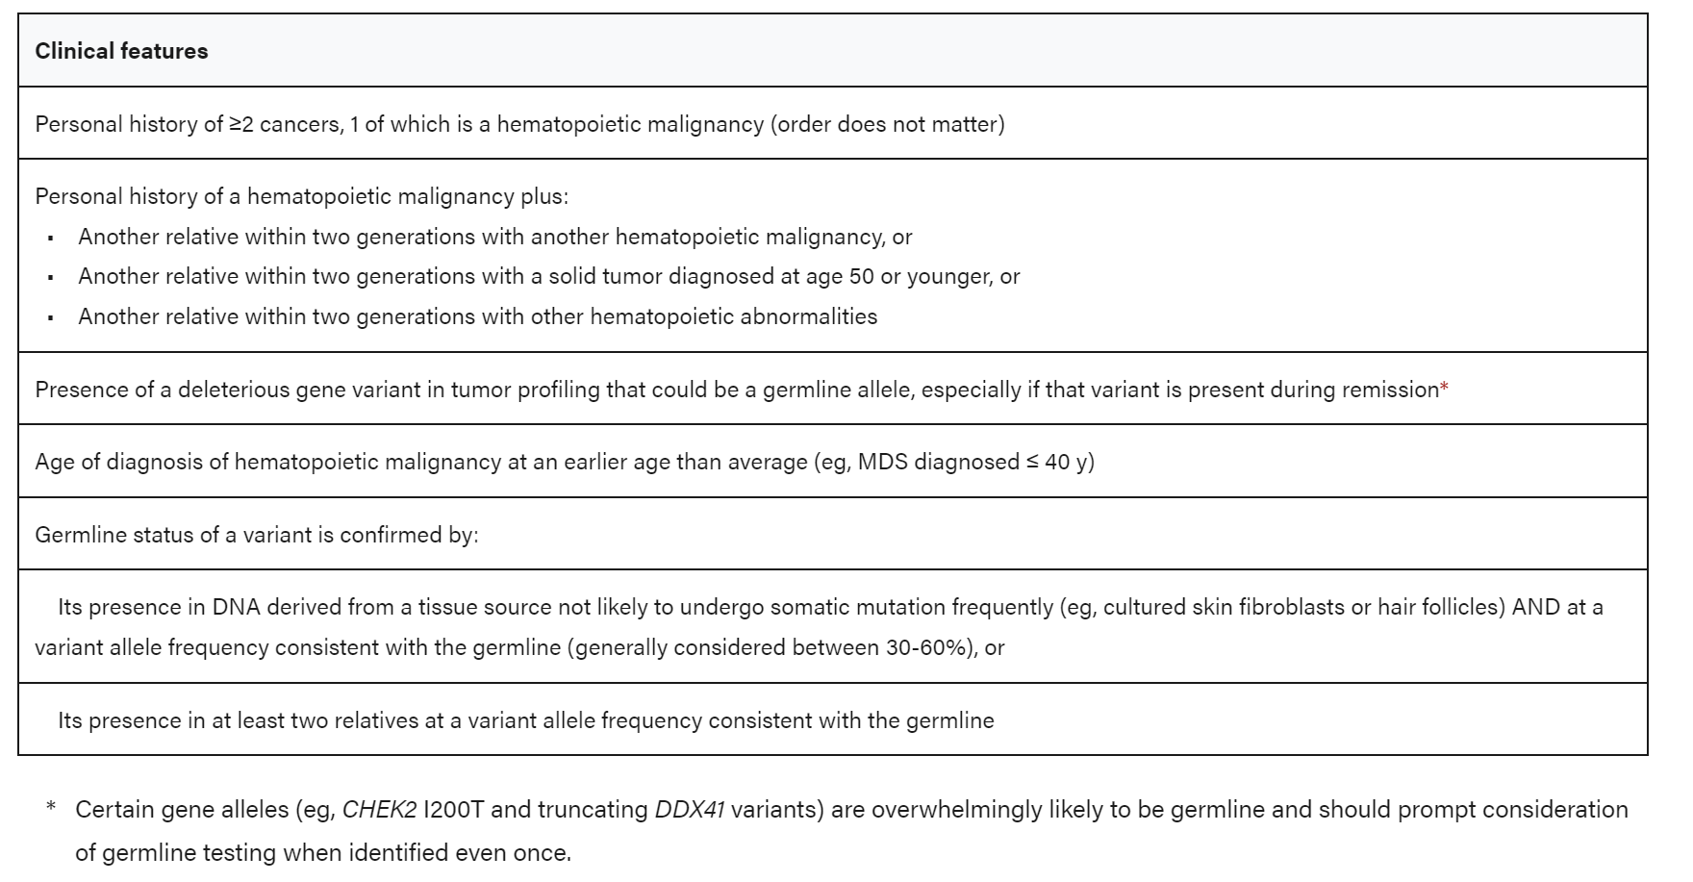
Clinical and genetic features indicating germ-line predisposition testing
Notes:
Dhoner Blood 2022 ELN22

Slide 19
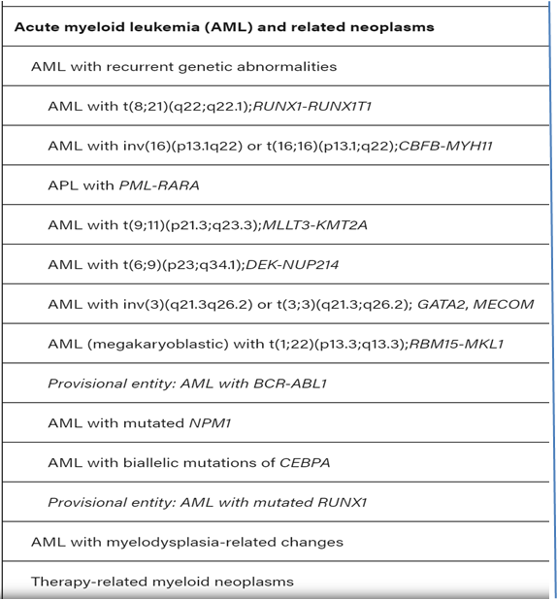
Nomenclature
Major clinical and pathogenetic distinction
Primary or de novo AML
Secondary AML
Secondary to previous therapy (tAML)
Secondary to previous hematological disease
Myeloid neoplasms associated with germline predisposition
WHO Classification
Importance of genetics
AML not otherwise specified (NOS)
AML with minimal differentiation
AML without maturation
AML with maturation
Acute myelomonocytic leukaemia
Acute monoblastic and monocytic leukaemia
Acute erythroid leukaemia
Acute megakaryoblastic leukaemia
Acute basophilic leukaemia
Acute panmyelosis with myelofibrosis
Myeloid sarcoma, Myeloid proliferations related to Down syndrome, blastic plasmacytoid dendritic cell neoplasm
Notes:
Khoury, J. D., Solary, E., Abla, O., Akkari, Y., Alaggio, R., Apperley, J. F., Bejar, R., Berti, E., Busque, L., Chan, J. K., Chen, W., Chen, X., Chng, W., Choi, J. K., Colmenero, I., Coupland, S. E., Cross, N. C., De Jong, D., Elghetany, M. T., . . . Hochhaus, A. (2022). The 5th edition of the World Health Organization Classification of Haematolymphoid Tumours: Myeloid and Histiocytic/Dendritic Neoplasms. Leukemia, 36(7), 1703-1719. https://doi.org/10.1038/s41375-022-01613-1
Pallister, C and Watson MS. Haematology. Scion Publishing 2011.
Deschler B, Lübbert M. Cancer 2006, 107(9):2099-107.
Sant M, et al. Ann Oncol 2003;14 Suppl 5:v61-118.
Swerdlow SH, et al. Lyon: IARC Press; 2008.
Arber DA, et al. Blood (2016) 127 (20): 2391–2405.

Slide 20
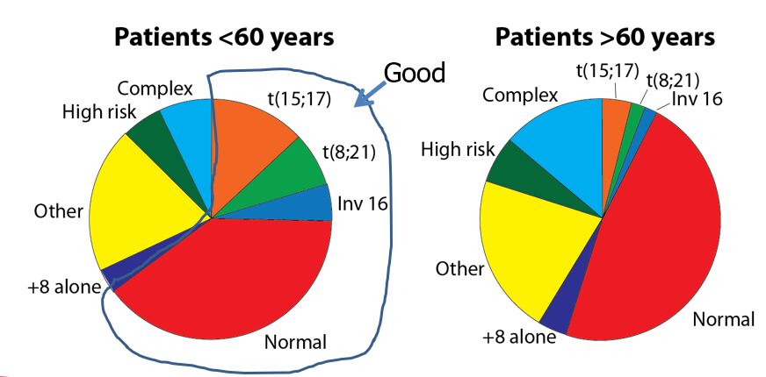
Prognostic Indicators
Age
5-year survival of AML patients <65 years about 40%
5-year survival of AML patients 65-74 years about 11%
5-year survival of AML patients >75 years about 1%
De novo vs secondary AML
WBC at presentation
CNS disease
Cytogenetics and Mutations
good prognosis: t(15;17), t(8;21), inv(16), NPM1
poor prognosis: -7, del(7q), -5, del(5q), 3q21/3q26 abnormality, complex karyotype, TP53, ASXL1, “Myelodisplasia-like mutations”
Treatment response
Advanced age is a poor prognostic factor
- Reduced ability to tolerate chemotherapy or transplant
- Different disease biology
Frequent adverse cytogenetic profile
Frequent antecedent hematologic disorder
Notes:
Dhoner, Blood 2022, ELN2022
Pallister, C and Watson MS. Haematology. Scion Publishing 2011.
SEER Faststats; Available from: http://seer.cancer.gov/faststats/index.php.
Döhner H, et al. Blood 2010, Jan 21;115(3):453-74.
Burnett, A.K., and Venditti, A. Postgraduate Haematology. Oxford: Blackwell Publishing Ltd; 2011.
Grimwade D, Walker H et al.. Blood 1998, Oct 1;92(7):2322-33.
Grimwade D. Blood 2001, Sep 1;98(5):1312-20.

Slide 21
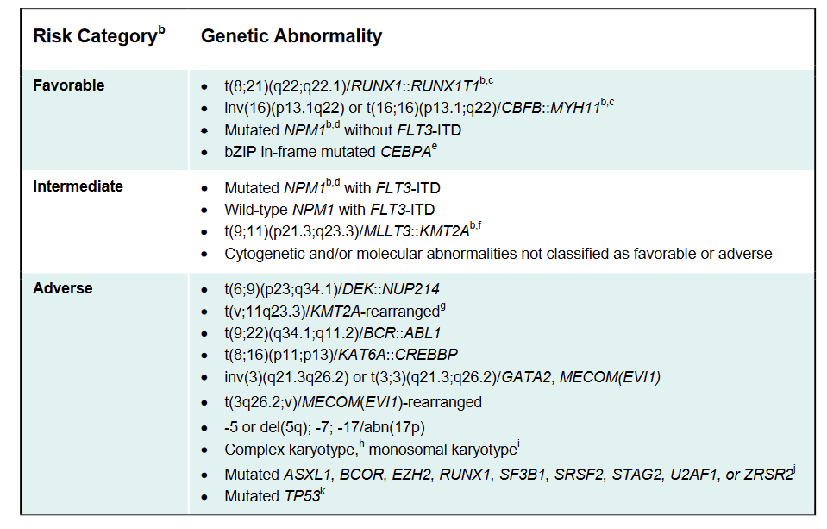
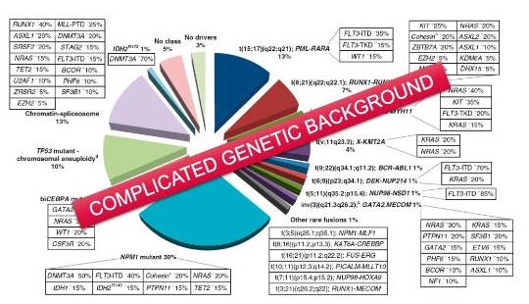
Prognostic genetic markers
AML is a heterogeneous malignancy characterized by recurrent genetic, epigenetic and metabolic abnormalities. There are at least 50 genes in which mutations have been identified in AML
Genomic landscape of AML reveals distinct molecular subgroups informing disease classification and prognosis stratification.
Complicated genetic background
ELN 2022 AML risk stratification by genetics
Notes:
Dhoner Blood 2022
Jahn N, Panina E, et al. ASH 2018, abstr 1534; *Stone R, et al. N Engl J Med. 2017;377(5):454-64.

Slide 22
Diagnostic and Prognostic work-up
Classical testing
Genetic profile
Molecular screening
PML-RARA
RUNX1-RUNX1T1
CBFB-MYH11
KMT2A rearrangements
BCR-ABL1
NPM1
FLT3
IDH1/2
Karyotype
RUNX1
ASXL1
TP53
NGS gene panel*
*including CEBPA, DDX41, TP53, ASXL1, BCOR, EZH2, RUNX1, SF3B1, SRSF2, STAG2, U2AF1, ZRSR2
and possibly ANKRD26, BCORL1, BRAF, CBL, CSF3R, DNMT3A, ETV6, GATA2, JAK2, KIT, KRAS, NRAS, NF1, PHF6, PPM1D, PTPN11, RAD21, SETBP1, TET2, WT1
Peripheral blood count
Peripheral blood morphology
Bone marrow
Morphology
Multiparameter flow cytometry (Leukemia-assoc. immunophenotype)
Within 10 days
Cytogenetics
within 3-5 days
within 5-7 days
within 1st cycle
Notes:
ELN22 (dhoner, blood, 2022)

Slide 23
Mechanisms of illness of AML
AML causes morbidity and mortality through three general mechanisms:
Deficiency in normal blood cell number or function
Replacement of normal with malignant cells (crowding out)
Direct growth inhibition
Consequences
Infection - Due to abnormal white blood cells (neutrophils)
Haemorrhage - Due to abnormal platelets and disseminated intravascular coagulation
Anaemia - Due to reduced red cell count
Invasion of vital organs with impairment of organ function
Systemic disturbances by metabolic imbalance
Cytotoxic chemotherapy is also associated with significant morbidity
Often difficult to distinguish between treatment effects and disease effects
Notes:
Pallister, C and Watson MS. Haematology. Scion Publishing 2011
Infection is one of the most common causes of death and a significant cause of morbidity in acute leukaemia. The increased infection risk is caused by impaired host defence due to neutropenia or neutrophil dysfunction. Neutropenia may be caused by the ‘crowding out’ of normal neutrophil production by leukaemic tissue in the bone marrow or cytoreductive therapy. The usual hallmark of infection is fever. Unfortunately, the leukaemic process itself can cause fever, leading to complications in the recognition of infection. Differentiation between fever caused by infection and fever caused by the leukaemia process itself often is difficult. Typically, humoral and cell‑mediated immunity are normal in acute leukaemia but, as the disease progresses, immune function deteriorates and the frequency and severity of infection increases.
The prevention of infection is a vital part of the treatment of acute leukaemia. Antibiotic regimes are implemented at the first sign of fever because of the association of infection with mortality. In some cases, severely neutropaenic patients are treated with prophylactic antibiotics, regardless of signs of infection.
Haemorrhage is a common problem in acute leukaemia both at presentation and during treatment. Usually it is the direct result of thrombocytopenia, but may be secondary to qualitative defects of platelets or disseminated intravascular coagulation (DIC). The risk of severe haemorrhage is inversely related to the circulating platelet count: life‑threatening haemorrhage is unlikely until the platelet count falls below 20 x 10⁹/l. Occasionally, platelet dysfunction can result in bleeding problems at higher platelet counts. In either case, the most effective form of treatment is platelet transfusion. Some treatment centres aim to prevent haemorrhage by a regime of prophylactic platelet transfusion.
Disseminated intravascular coagulation is particularly troublesome in M3 leukaemia due to the presence of thromboplastin‑like substances in the abnormal granules of the leukaemic promyelocytes, but it may be seen in any form of acute leukaemia. As described in Chapter 18, Gram‑negative septicaemia is associated with intractable DIC, which commonly results in death.
Normocytic, normochromic anaemia is extremely common in acute leukaemia and is responsible for the symptoms associated with fatigue and a sense of ill health. The severity of the anaemia typically reflects the severity of the disease. The unregulated proliferation of leukaemic tissue results in the physical ‘crowding out’ of normal haemopoietic elements, leading to a reduction in erythropoiesis, thrombopoiesis and leucopoiesis. In some cases, ineffective erythropoiesis or, more rarely, haemolysis may exacerbate the anaemia. In most anaemic individuals, erythropoietin levels are raised in proportion to the degree of anaemia but the normal erythroid precursors show diminished responsiveness to this hormone. It is thought that leukaemic cells elaborate one or more inhibitors of normal haemopoiesis.

Slide 24
Traditional AML Treatment: Induction Chemotherapy (IC)
Rationale
Usually for fit patients
Intensity of treatment depends on patient’s age and health
In younger patients (e.g., < 60 years), induction often involves treatment with 2 chemotherapy drugs
Still 7+3 (since 1973!) = 7 days of cytarabine (ara-C) + 3 days of anthracycline
- A target agent may be added (i.e. Gentuzumab for cor binding factor leukemia or midostaurin/quizartinib for FLT3)
Pt > 60 years: some older fit patients may benefit from similar or slightly less intensive treatment
Aims to induce complete remission (CR) (= quickly getting rid of as many leukemia cells as possible)
Bone marrow blasts <5%
Improvements (near normalization) of blood counts
Impact of Age on CR rate
Age (years) | <35 | 35-55 | 56-60 | 61-65 | 66-70 | 71-75 | >75
CR rate (%) | 88 | 82 | 77 | 62 | 63 | 48 | 59
Notes:
Stone NEJM 2017
Amadori JCO 2016 Cheson BD, et al. J Clin Oncol 2003, Dec 15;21(24):4642-9.
Burnett AK, Venditti A. Postgraduate Haematology. Oxford: Blackwell Publishing Ltd; 2011.

Slide 25
Traditional AML Treatment: Induction Chemotherapy (IC)
Predictors of poor response
Poor performance status
Age >60 years
Unfavorable karyotype e.g., complex karyotype, monosomal karyotype
Antecedent hematological disease
Unfavorable gene mutations e.g., FLT3‐ITD, TP53
Secondary AML
Treatment‐related AML
AML with myelodysplasia‐related changes
Typically, good responders
Core-binding-factor leukemias (without c‐KIT mutation) → t(8;21), t(16;16), inv(16)
Diploid AML with NPM1 or CEBPA mutation (without FLT3 mutation)
Notes:
Döhner H, et al. Blood 2010, Jan 21;115(3):453-74

Slide 26
Traditional AML Treatment: Induction Chemotherapy (IC)
How is 7+3 administered in hospital ?
Administer chemotherapy
Day 14 bone marrow analysis: goal is “empty” i.e.:
<10% to 20% cellularity,
residual blasts < 5% to 10%
Day 14 bone marrow may be omitted
If blasts remain, re-induction is appropriate
Await recovery (usually at least 21 days from start)
Empty marrow ≠ remission!
CR determined by morphology (microscope)
cellular marrow < 5% blasts,
independent of transfusions,
neutrophils ≥ 1000/µL,
platelets ≥ 100K/µL
Determination of minimal residual disease (MRD) by laboratory assessment (flow cytometry or gene profiling) as it predicts relapse
Note: Some slightly modified versions of 3+7 may be administered at induction (e.g. FLAG-Ida add fludarabine to standard anthracycline+cytarabine drug combination. CPX-351 is a lyposomal formulation of 3+7 with enanched effectiveness in secondary or MDS-related disease).

Slide 27
Traditional AML Treatment: post-IC
Consolidation
Induction considered successful if remission is achieved
Further treatment (ie, consolidation) given to try to destroy any remaining leukemia cells and help prevent a relapse
Options
For younger patients (typically < 60 years), main options for consolidation therapy include:
Several cycles of chemo with high-dose cytarabine (ara-C; HiDAC)
Allogeneic (donor) stem cell transplant
The best option for each patient depends on the risk of the leukemia coming back after treatment, as well as other factors
Patients unfit for transplant may receive maintenance therapy with oral azacitidine (i.e. CC-486)

Slide 28
Other options for patients who cannot receive IC
Low dose ara-C (sometimes toghether with glasdegib, that modify acute leukemia cells-microenvoironment interactions increasing the chance of transfusion independency)
Hypomethylating agents (HMA)
Effective also in older patients with adverse cytogenetics
Commercially available
Azacitidine
Decitabine
How do they work?
slow the production of leukemia cells and help the bone marrow produce more healthy and normal functioning cells
meaningful clinical activity
improved survival, even if complete remission is not achieved.
Goals of therapy
to help increase blood cell counts, disease remission is unlikelly
not commonly given with the goal of cure, but may help patients live longer
Notes:
Dombret H, et al.Blood 2015;126(3):291-9.
Fenaux P,, et al. J Clin Oncol 2010;28(4):562-9.

Slide 29
Other options for patients who cannot receive IC
Hypomethylating agents (HMA)+ Venetoclax
How do they work?
Inhibiting a protein (bcl2) that is important for leukemia survival, Venetoclax association potentiate hypometilating agents activity.
Due to increased risks of the assocciation, it can be used only whenever the overall performance status of the patient is good, in order to avoid severe toxicities
Goals of therapy
to achieve disease remission
to help increase blood cell counts
not commonly given with the goal of cure, but may help patients live longer
Notes:
Dombret H, et al.Blood 2015;126(3):291-9.
Fenaux P,, et al. J Clin Oncol 2010;28(4):562-9.

Slide 30


Other options for patients who cannot receive IC
Drug | Target
Midostaurin | FLT3 and de novo
Quizartinib | FLT3 without TKD mutation
CPX-351 = liposomal formulation of cytarabine and daunorubicin | Newly diagnosed, AML-MRC / tAML
Gemtuzumab Ozogamicin (GO) | CD33 –frontline AML
Ivosidenib oral | IDH inhibitors + IC in patients with newly diagnosed AML with IDH1 mutation
Glasdegib oral | Sonic hedgehog – frontline of IC not indicated, in combo with ARA-C
Venetoclax oral | BCL2 - frontline AML if IC not indicated in combo with HMA or low dose ARA-C

Slide 31
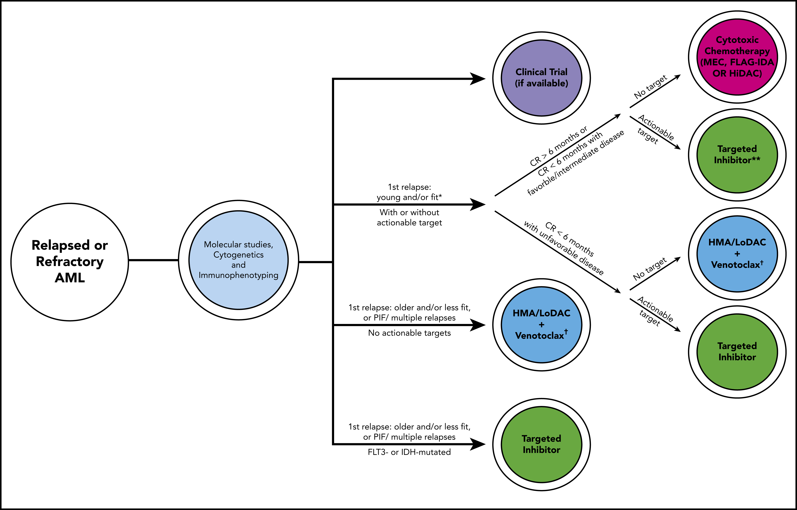
Options for relapsed/refractory (R/R)* AML
Drug | Target
Enasidenib oral | IDH2 mutation and R/R AML
Ivosidenib oral | IDH1 mutation and R/R AML
Gilteritinib oral | FLT3 mutation and R/R AML
* Relapsed/refractory = patients who cannot achieve complete remission

Slide 32
Promising developments
Azacitidine ± Venetoclax in relapse/refractory patients
Chances of remissions
Prolongs survival
Total oral therapy
With CC-486 approval and Decitabine/cetazuridine approval patients candidate to hypomethylating agents based combinations may receive only-oral combinations with equivalent activity of subcutaneous or IV formulations
Target antigens and novel antibodies (e.g. BiTE targettig CD33, CD123, FLT3)
Gliteritinib + AZA in newly diagnosed FLT3 mutant AML unfit for IC
Enasidenib Plus AZA vs AZA in Mutant IDH2 Newly Diagnosed AML
Advantage on event-free survival
CPX-351 in combination with venetoclax, midostaurin or enasidenib for first line treatment in fit patients
Cellular therapies, especially NK-cell based
→ Combination therapies seem to be promising AML is genetically highly heterogeneous and sensitivity to single agents is genotype dependent
Notes:
DiNardo. NEJM 2020
Wei. ASH 2019. Roboz, EHA 2020
Wang ES et al ASH 2020 Abstract 27
DiNardo. ASH 2019. Abstr 643.

Slide 33
TP53 mutations – why are they bad ?
TP53 mutations are seen in 5-10% of de novo MDS/AML and increase to 25-40% in therapy related AML
TP53 mutations are seen in 50% of those with complex karyotype
Poor and/or very short response to treatment, including intensive chemotherapy, hypomethylating agents, and high risk of relapse post allogeneic SCT

Slide 34
TP53 mutations - treatments
Immunotherapies and cellular therapies
Response to immunotherapies and cellular therapies are not directly influenced by genomic; e.g.:
Sirp-alpha antagonists or anti-cd47 drugs
Activate macrophages to phagocyte leukemia cells
NK cells memory-like
Early trials in pediatric population demonstrate a response rate of about 60% irrespective of genomic
There’s no drug in advanced development at the moment

Slide 35
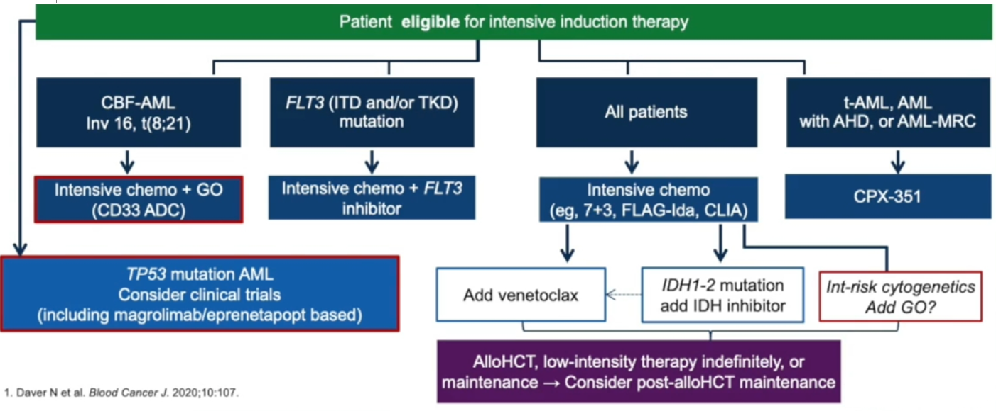
Guidelines for fit patients

Slide 36
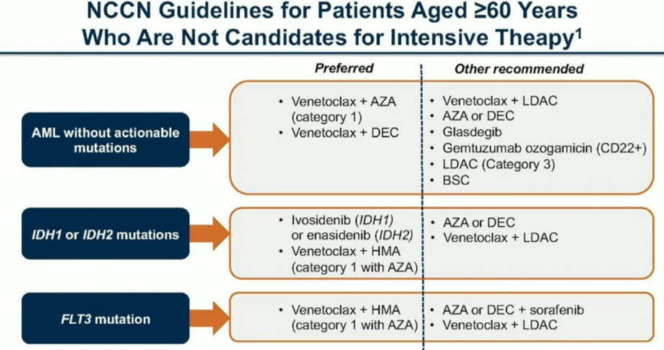
Guidelines for elderly patients not candidates for IC
Notes:
NCCN Guidelines

Slide 37
Summary and Conclusion
Individualized treatments for AML
Flt-3 mutated AML: incorporate Flt-3 inhibitor to HMA
IDH1/IDH2 mutated AML: incorporate inhibitor to HMA
Venetoclax + HMA standard of care for those not candidates for IC
Maintenance therapy required (with HMA?)
Significant number of promising agents in development
Combination therapy may further increase efficacy
Oral combinations are warranted to improve quality of life
Future for AML treatment appears promising

Slide 38
More information
Patient information
https://media.leukaemiacare.org.uk/wp-content/uploads/Adult-Acute-Myeloid-Leukaemia-AML-Web-Version-1.pdf
https://www.cancer.org/cancer/acute-myeloid-leukemia/about/what-is-aml.html
https://www.lls.org/leukemia/acute-myeloid-leukemia?src1=20032&src2=
https://www.cancercenter.com/cancer-types/leukemia/types/acute-myeloid-leukemia
Latest advances
https://acuteleuk.org/news-events/
https://www.annalsofoncology.org/article/S0923-7534(20)36079-8/fulltext

Slide 39
Acute Lymphocytic Leukemia (ALL)

Slide 40
What is ALL
Acute lymphocytic leukemia (ALL) is a cancer that starts in blood stem cells. Stem cells are basic cells that develop into different types of cells that have different jobs.
Aggressive malignancy of B or T lymphocytes
It is called acute because it develops quickly = emergency
As the stem cells of the blood develop, they become blast cells (blasts), which are immature blood cells. In leukemia, there is an overproduction of blast cells. These blast cells develop abnormally and don’t develop into mature blood cells. Over time, the blast cells crowd out normal blood cells so that they can’t do their jobs. When leukemia is diagnosed, these blast cells may be called leukemia cells.
Acute lymphocytic leukemia is also called acute lymphoblastic leukemia.
ALL is the least common of the 4 major types of leukemia in adults.
It is the most common type of leukemia diagnosed in young children
it occurs more often in boys than girls.

Slide 41
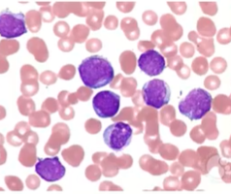
Signs and symptoms
Most patients present signs and symptoms of bone marrow failure, e.g.
Bleeding
Reccurent infections
Tiredness
When blood test is performed >90% have circulating blasts (=leukemia cells) on blood smear (=film)

Slide 42
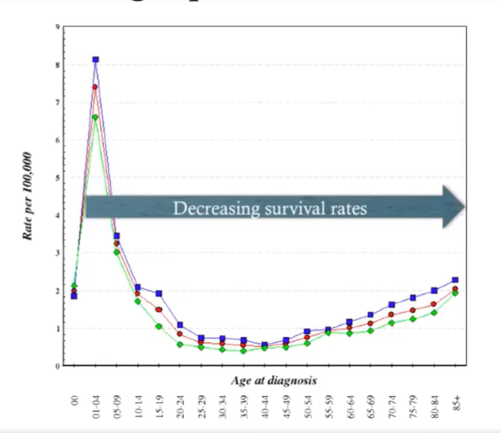
Who gets ALL ?
ALL is primarly a disease in children
Average is age of 6
Less common in late teenage
Rare in 30-40s
Increase again >70
Notes:
SEER

Slide 43
Diagnosis
Microscopy
Blood and bone marrow examination
Presence of leukemia cells
But cannot tell which type of ALL
Flow cytometry
Cells surface markers can be detected e.g. CD19, CD2, CD22, CD20
Help to know whether it is B or T cell ALL
Molecular techniques such as PCR
Detection of specific molecular abnormalities
Guide treatment decision
Help determine risk score

Slide 44
Cytogenetics
Some abnormalities in the DNA of the cancer cells have good risk (= good chance of cure)
E.g., in children: TEL-AML1(ETV6-RUNX)
High hyperdiploidy (51-65 chromosomes)
But others have poor risk (= usually leads to very specialized treatment and/or bone marrow transplant)
Hypodiploidy
MLL rearragements
→ Important for planning treatment

Slide 45
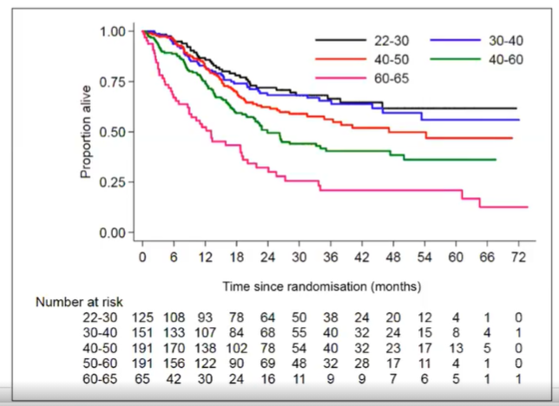
Effect of age on outcomes
Patients < 40 (black and blue lines) have the best outcomes
Every decade >40 the outcomes for patients get worse
Particularly poor for patients >60
Notes:
UKALL14

Slide 46
Reasons for poorer outcomes in elderly
Probably a mixture of
Different biology of the disease
Different biology of patients e.g. concomitant conditions
Recruitment in clinical trials – missing information and clinical trial evidence on how best to treat older patients
Protocol and aim of the therapy

Slide 47
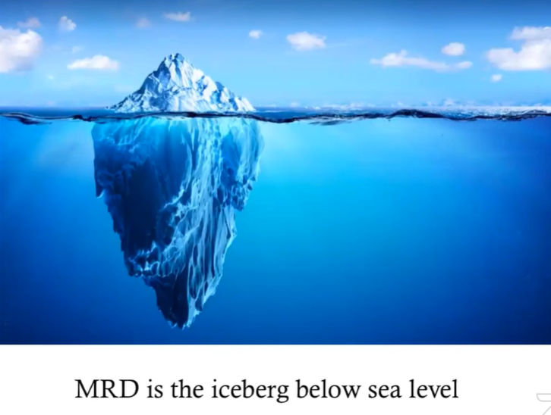
Aim of therapy
Elimination of disease = achieving remission
+
Prevention of recurrence of disease (relapse)
Importance of Minimal Residual Disease (MRD)

Slide 48

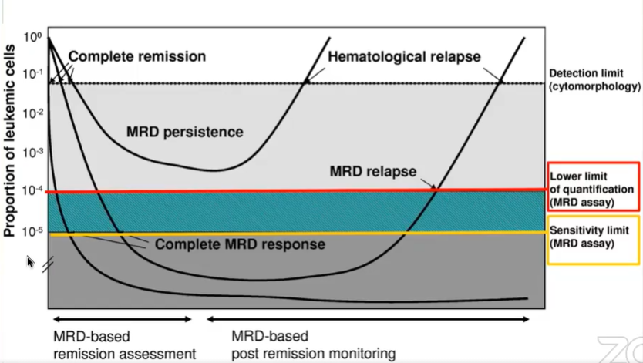
MRD based terminology for defining treatment response
Iceberg = patient
Sea level = disease you can see by eye
Below sea level = disease you can see with specific technics
Notes:
Brugemann M et al. Blood 2012

Slide 49
Risk criteria
Increased risk if:
Age > 40 years
WCC > 30x10⁹/1 (B cell) or > 100x10⁹/1 (T cell)
Poor risk cytogenetics
MRD persistence after induction = first month of treatment
→ All “increased-risk” patients advised to have stem cell transplant if a suitable donor is available

Slide 50
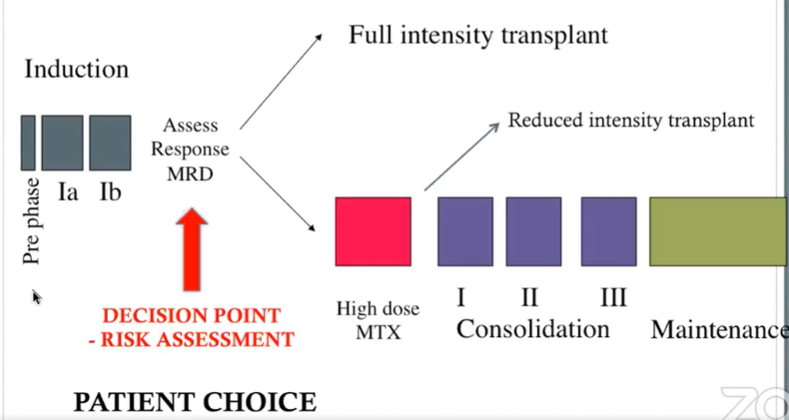
Schema for adult ALL therapy

Slide 51
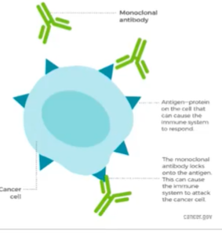
What is new?
Immunotherapy
Monoclonal antibodies recognize the markers present on the cell (CDxx)
Anti CD20 therapy – Rituximab
In B cell ALL
Addition of 16-18 doses of rituximab to chemotherapy reduces the risk of relapses
No increase in toxicity
Improved event-free survival
Anti CD19 therapy - Blinatumomab
Notes:
Maury et al. NEJM 2016 – GRAALL study

Slide 52
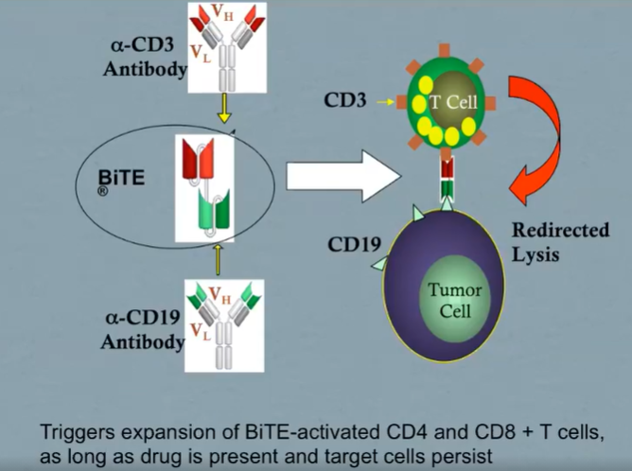
What is new?
Immunotherapy
Anti CD19 therapy – Blinatumomab
Licenced for use in B cell for
Persistently detectable MRD
Relapsed disease
Can convert MRD + remissions into MRD - remissions
More effective at treating relpased B cell ALL than standard chemotherapy
But ioesn’t live very long in blood stream so it has to be given as continuous intravenous infusion (via a pump)
Drug is stable for 4 days
If pump stops working for >4h it has to be thrown away
subcutaneous formulation for weekly dosing is in develpment

Slide 53
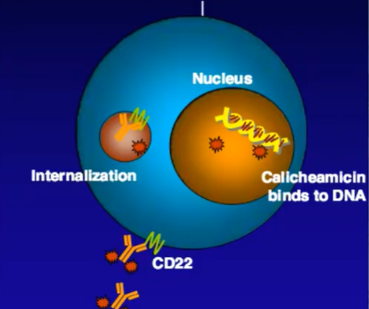
What is new?
Immunotherapy
Anti CD22 therapy – Inotuzumab
Licenced for treatment relapsed B cell ALL
Significantly more effective in treating relapsed B cell ALL than standard chemotherapy
Less side effects
Encouraging data for use in elderly as first line therapy in combination with tolerable chemotherapy
Can be given as outpatient treatment – short infusion
Notes:
Kantarjan NEJM 2016

Slide 54
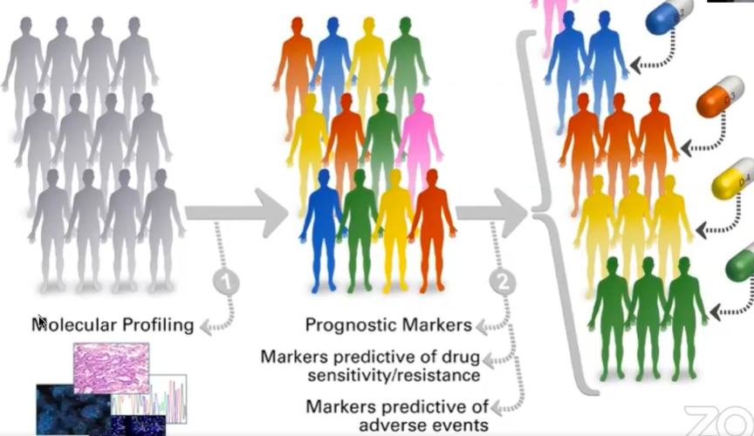
What is new?
Personnalized cancer therapy
E.g., CART cell therapy

Slide 55
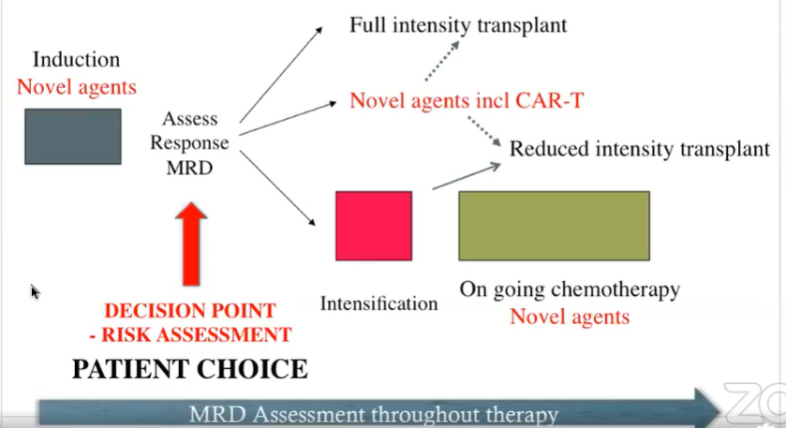
Potential schema for adult ALL therapy moving forward adapted for elderly patients

Slide 56
Future challenges for adult ALL
Prevention of relapses
Need better predictor of relapse
Improved therapies for targeting MRD
Understanding how to use novel therapies in front line treatments
Reduction of toxic side effects
More options for patients with T cell disease
Understanding the role of CAR-T cell therapies versus stem cell transplantation
More clinical trials especially for older adults

Slide 57
More information
Patient information
https://media.leukaemiacare.org.uk/wp-content/uploads/Adult-Acute-Lymphoblastic-Leukaemia-ALL-Web-Version.pdf
https://www.cancer.org/cancer/acute-lymphocytic-leukemia.html
https://www.lls.org/leukemia/acute-lymphoblastic-leukemia?src1=20032&src2=
https://www.cancercenter.com/cancer-types/leukemia/types/acute-lymphocytic-leukemia
Latest advances
https://acuteleuk.org/news-events/

Slide 58
Other types of acute Leukemia

Slide 59
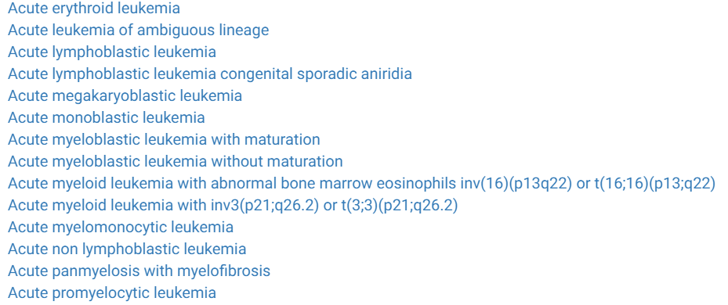
There are other types of acute leukemia which are rarer. E.g.
https://rarediseases.info.nih.gov/diseases/diseases-by-category/1/rare-cancers
Acute promyelocytic leukemia (APL)
https://media.leukaemiacare.org.uk/wp-content/uploads/Acute-Promyelocytic-Leukaemia-APL-Web-Version.pdf
https://www.verywellhealth.com/what-is-acute-promyelocytic-leukemia-apl-2252053
https://rarediseases.info.nih.gov/diseases/538/acute-promyelocytic-leukemia
https://www.youtube.com/watch?v=FDUNpXuUoKM

Slide 60
THANK YOU

